Slide 1
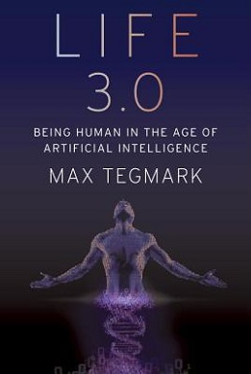
Book Review
By Zander Hartsuff

Slide 2
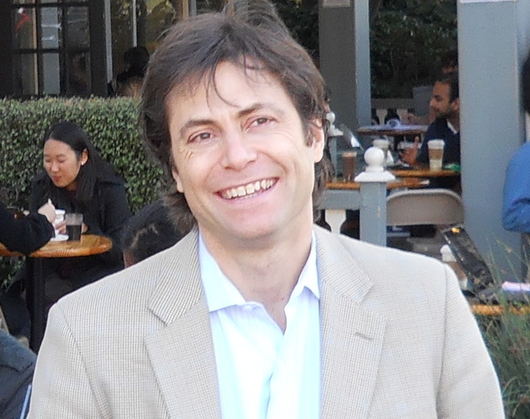
About the author: Max Tegmark
Professor of Physics and AI Research at MIT
Known for his work in Cosmology—science of origin and development of the universe
Education: B.S. Physics at Royal Institute of Technology (in Sweden where he grew up), MA and PHD from UC Berkeley
President of the Future of Life Institute
Goal: To ensure that future life exists and is as awesome as possible

Slide 3
The Greatest Discussion of our Lifetime
This book is about looking to the future of AI development and the potential effects it can have on the world
Defines Life 3.0 and other important terms
The road to creating Superhuman AI
The potential outcomes once it is created
The importance of maintaining control as we progress

Slide 4
The Three Categories of Life
Life 1.0: Bacteria
Life 2.0
Life 3.0: Superhuman AI
Life where Hardware and software are evolved rather than designed
Intelligence is limited by how much information can be transmitted at conception
Can only adapt by slowly evolving over many generations
Life whose hardware is not adaptable, but software can be redesigned
Hardware is fully realized when we reach full growth
Limitations: Death, brain capacity
Learning complex new skills—language, sports, professions
Fundamentally update goals and worldview
Adapt to things by “updating”
Fully realized ability to design its hardware and software
Master of its own destiny

Slide 5
How to reach Life 3.0
The key is reaching human level AGI
AGI (Artificial General Intelligence): The ability to achieve any cognitive task
If/when this ever happens any future will always have these two features:
A rapid takeoff in superhuman intelligence
One single entity in control: Humans or AI

Slide 6
Possible Future Scenarios (If Superhuman AI is created)
Libertarian Utopia: Humans and AI live together in harmony
The Benevolent Dictator: AI is put in charge of society due to greater intelligence, but still has humanity’s best interest in mind
Conquerors: AIs conquer and kill all humans
Possible reasons: view us as threat, nuisance, or waste of resources
Descendants: Humans will benefit from AI labors for a time, but eventually they will seek their own fortune while we fade away

Slide 7
His Views
Generally optimistic as long as we are not too ambitious and impatient
We need to be extremely careful with AI
Acknowledges the dangers and potential to hurt people with AI: priority to avoid these things
Research on AI safety with Future of Life Institute—to ensure that AI stays in our control moving forward

